Slide 1
CAMPUS MADNESS: STUDENT STRIKE FORCE
Save the University... Save the World!

Slide 2
RECAP OF ORIGINAL GAME
Top-Down Action/Adventure
Light-hearted theme based on Aliens attacking a school
Fast-paced, 2-player combat, multiple character types
Multiple themed levels with procedurally generated dungeon rooms
RPG-like elements, including attributes that increase upon level up or via items
Scoring mechanic that allows you to play for the high score

Slide 3
CRITQUES
Theme was positively received
Fast-paced action with multiple characters
RPG-like elements

Slide 4
CRITIQUES
Scoring Mechanic was not a valued feature
Scope of the game (5 characters and 5 levels) was seen as too much, difficult to balance
Procedural Generation was not a valued feature, suggested to go with more of a linear approach
Critiques were asking for something less like Binding of Isaac

Slide 5
MODIFIED ELEMENTS
Top-down combat changed to 2.5D brawler-style combat
Large 3D rooms with 2D sprites
Characters can move in 4 directions and can jump, but only face left or right
Mix of 2D and 3D allows for interesting effects and art styles
Easier for us to animate and create assets

Slide 6
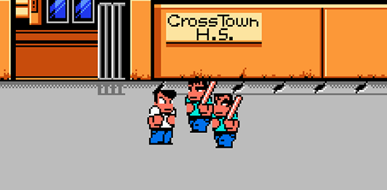
MODIFIED ELEMENTS
River City Ransom

Slide 7
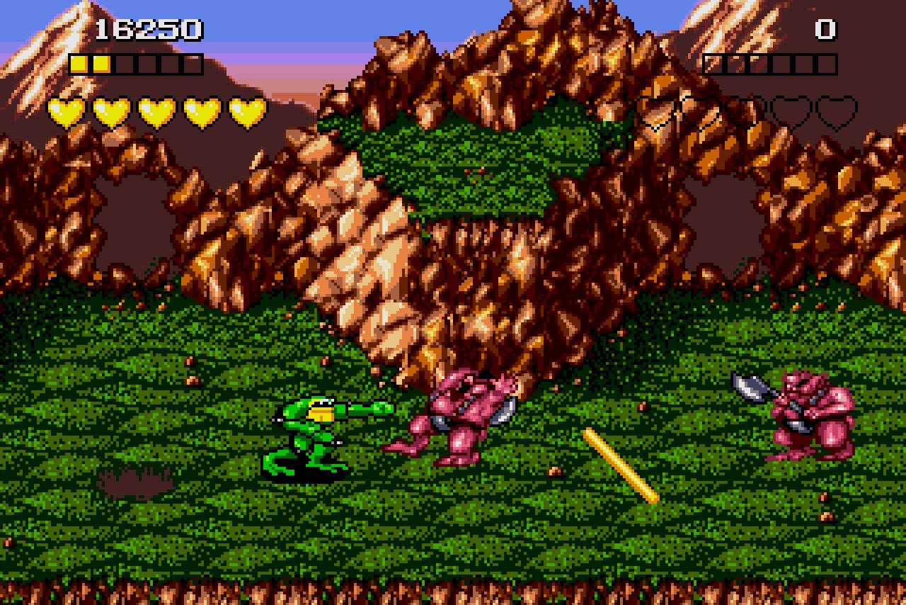
MODIFIED ELEMENTS
Battletoads

Slide 8
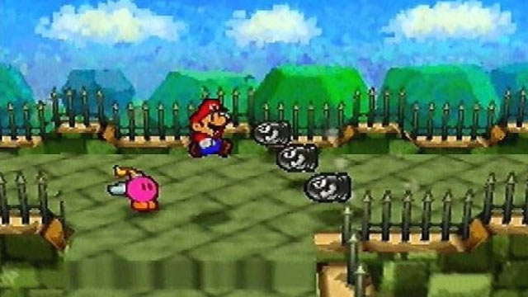
MODIFIED ELEMENTS
Paper Mario franchise

Slide 9
MODIFIED ELEMENTS
Linear levels, no procedural generation
Levels retain the same themes
Instead of small dungeons, levels are large 3D rooms connected by elevators and hallways
Levels still conclude with a boss fight
Can still only proceed after all enemies are defeated or key is found
New design allows us to be more creative with level design, placement of items, and hidden rooms

Slide 10
MODIFIED ELEMENTS
Boss Fights
Boss fights can use mechanics that take advantage of room design and new perspective
Slime Boss example
Removed Scoring mechanic
Reduced scope of game
Target is 3 characters instead of 5
Brawler, Markswoman, Assassin
Fewer than 5 levels, but the levels themselves are larger

Slide 11
GAMEPLAY DEMO

